Slide 1
CUSTOMER SEGMENTATION & COHORT ANALYSIS PROJECT

Slide 2
Table of Contents
Data Cleaning & Exploratory Data Analysis
RFM Analysis
Customer Segmentation
Applying K-Means Clustering
Create Cohort and Conduct Cohort Analysis

Slide 3
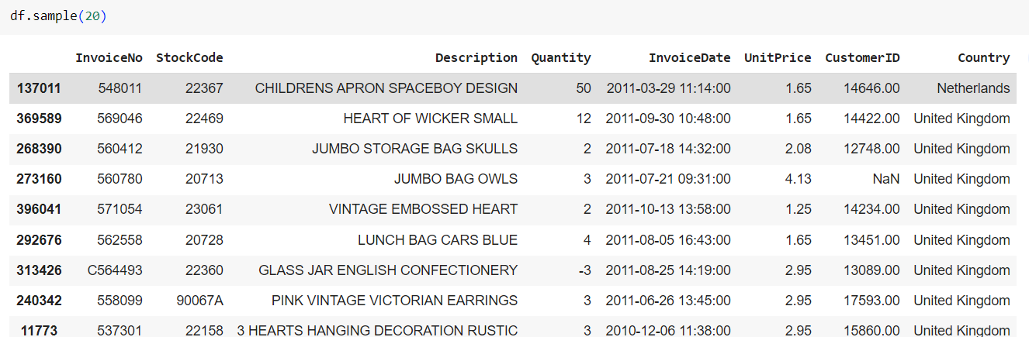
Data Cleaning
Null data !
Negative value in Quantity Column !
“C” in InvoiceNo Column !
“A” in StockCode Column !

Slide 4
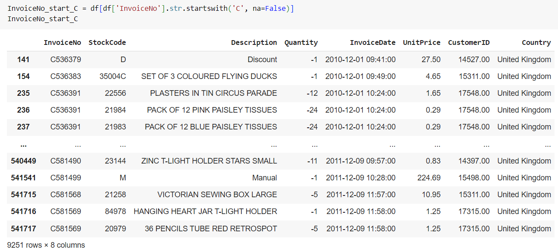
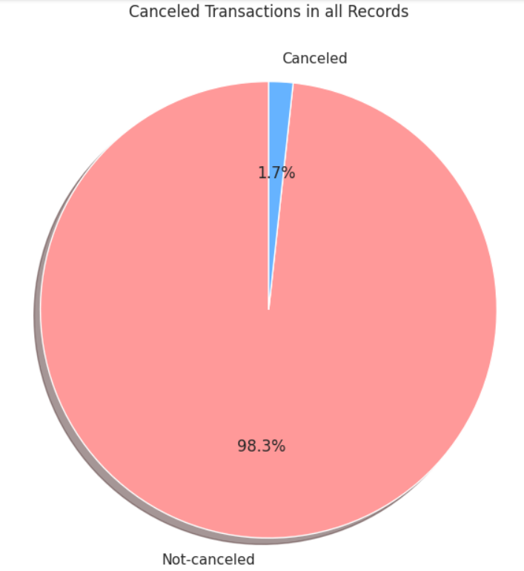
Data Cleaning
These are possibly canceled and returned orders.
These orders will not give us insight during the segmentation process ( best or lost customer).
So we will drop this rows.

Slide 5
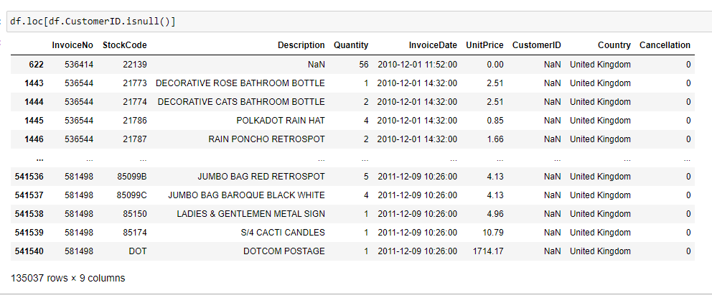
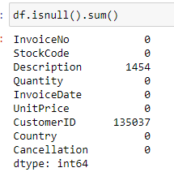
Handling Missing Values
We don't want to assign these orders to any customers.
Because this would alter the insights we will get from the data.
Drop this rows.

Slide 6
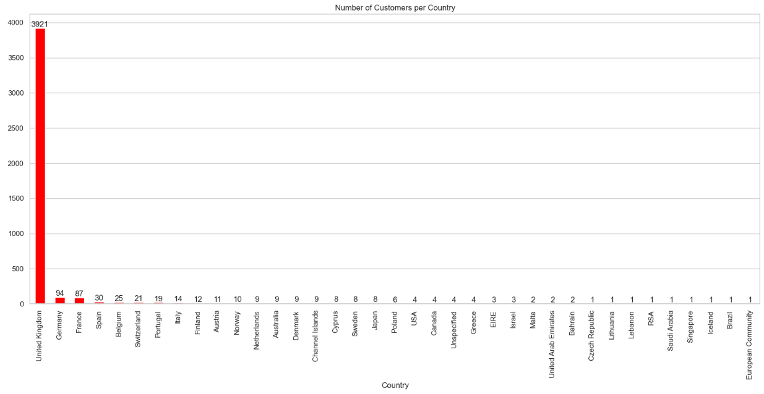
Exploratory Data Analysis

Slide 7
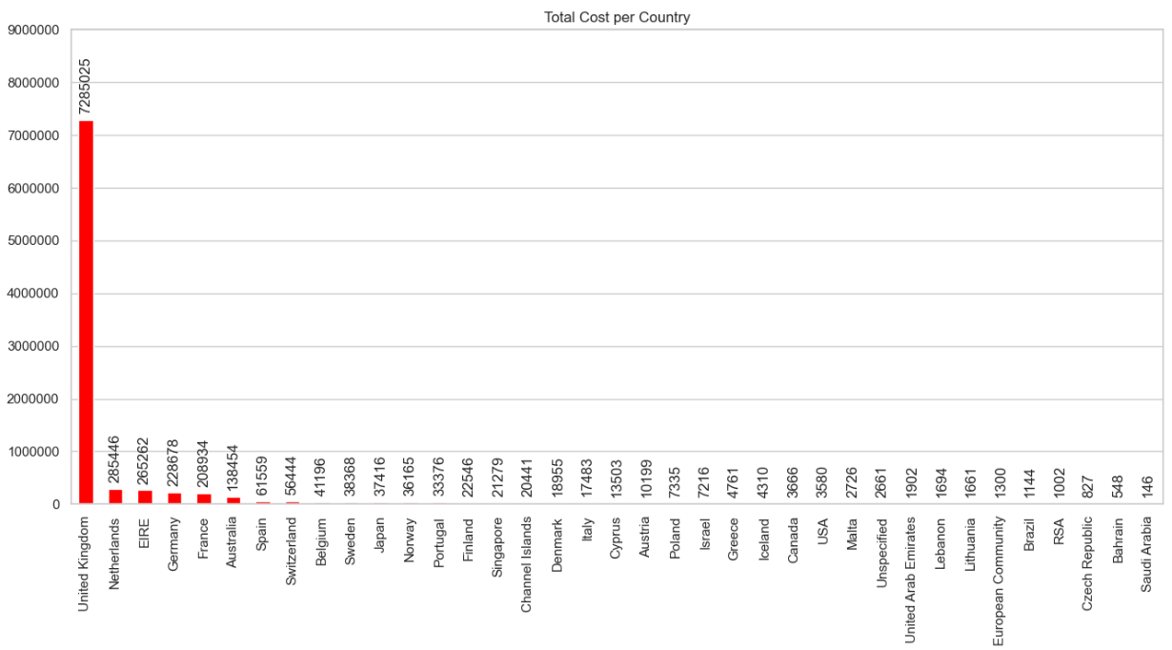
Exploratory Data Analysis

Slide 8
Exploratory Data Analysis
Majority of this dataset includes orders from the UK.
UK has most revenue.
Focus on the UK transactions data (df_uk).
Continue analyzing for customer segmentation.

Slide 9
RFM Analysis
RFM Analysis is a customer segmentation technique for analyzing customer value based on past buying behavior.
RECENCY (R): Time since last purchase
FREQUENCY (F): Total number of purchases
MONETARY VALUE (M): Total monetary value

Slide 10
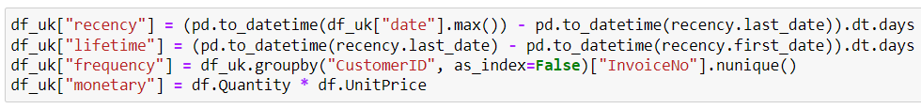
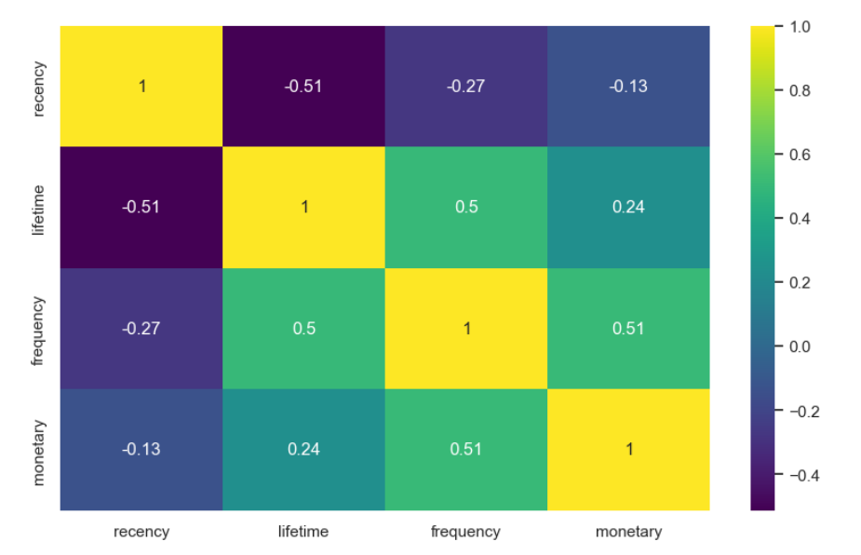
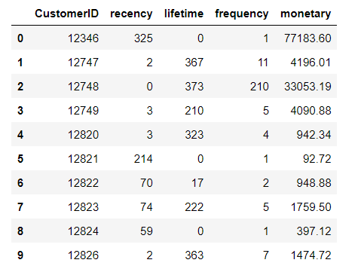
RFM Analysis

Slide 11
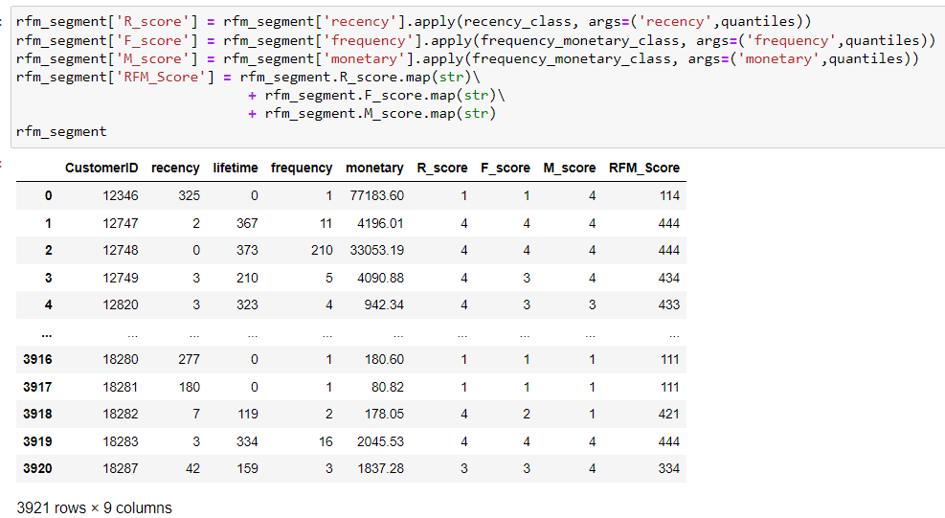
RFM Analysis

Slide 12
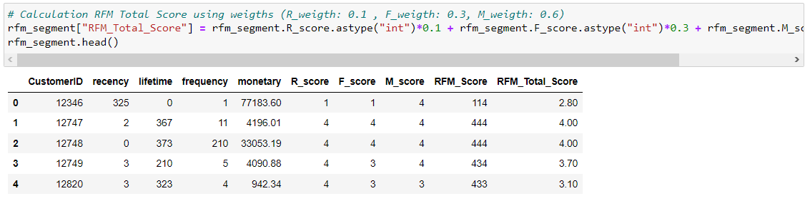
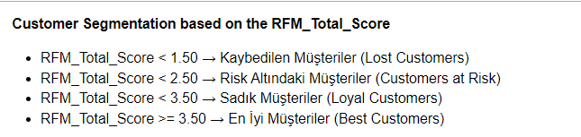
Customer Segmentation

Slide 13
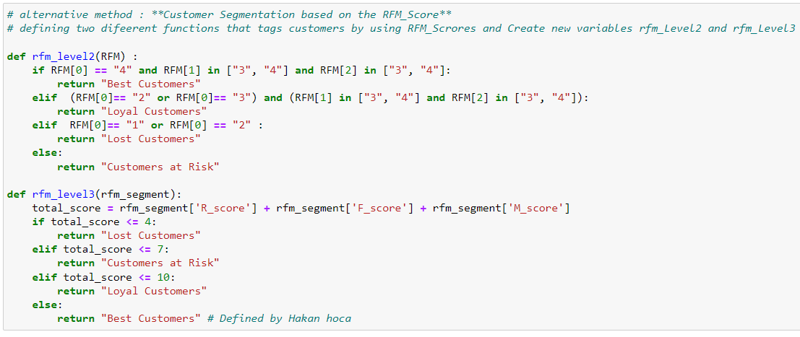
Customer Segmentation

Slide 14
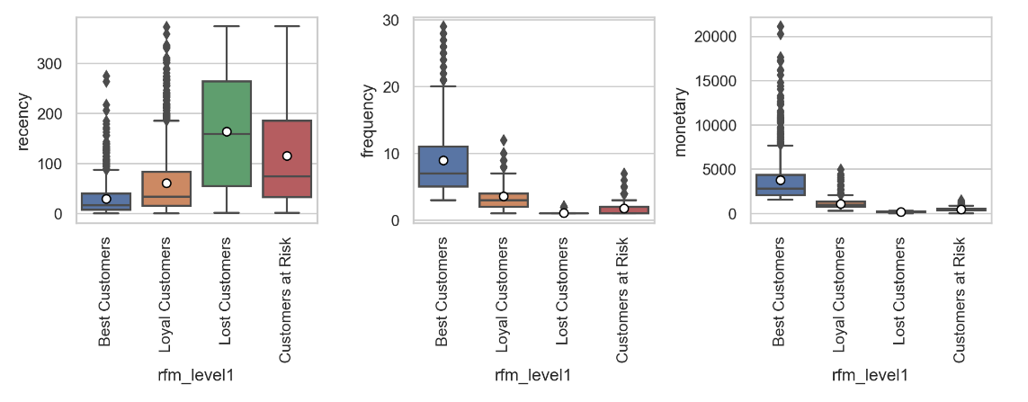
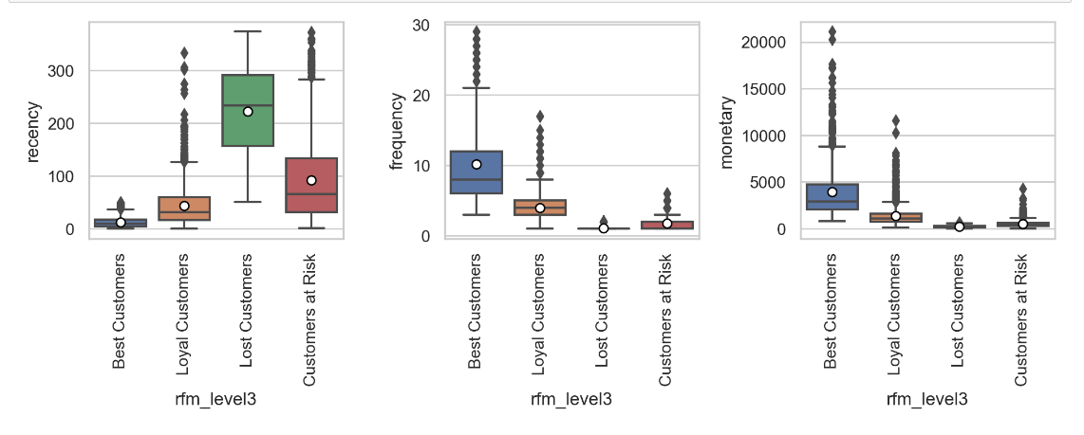
Customer Segmentation

Slide 15
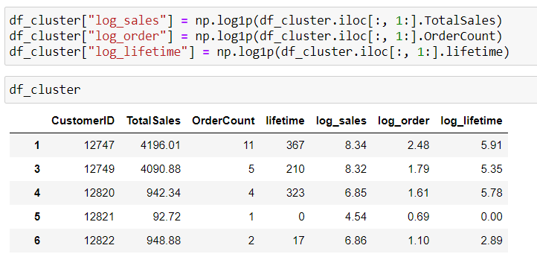
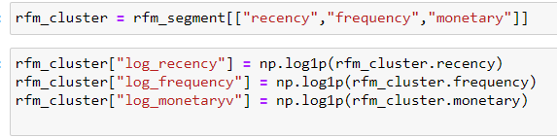
Applying K-Means Clustering
Data Normalization
Logarithmic Transformation can be used to normalize the values in a column.
Plot normalized data with scatter matrix or pairplot. Also evaluate results.

Slide 16

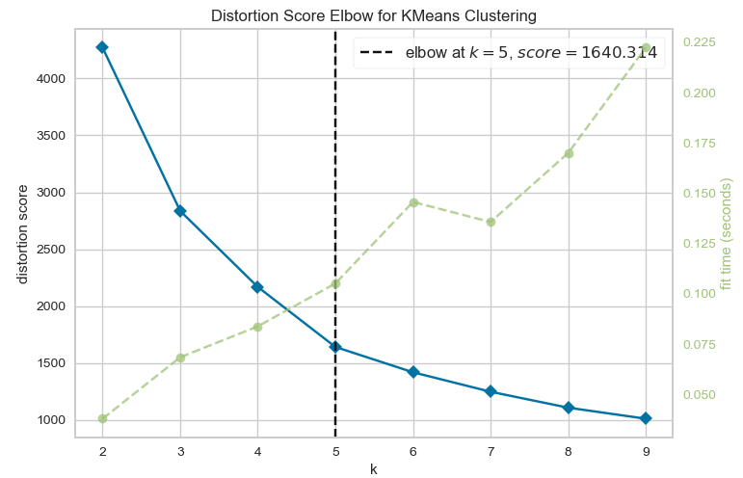
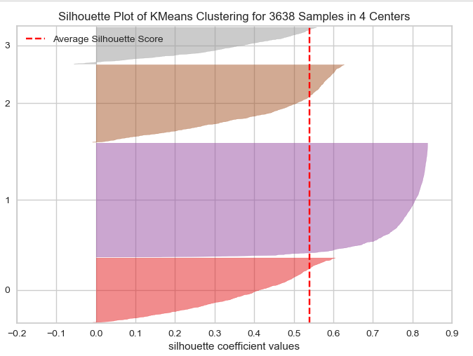
Applying K-Means Clustering

Slide 17

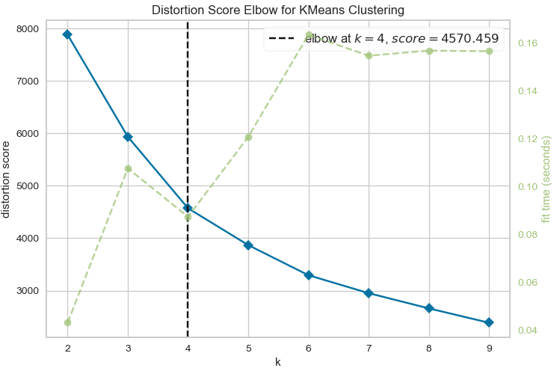
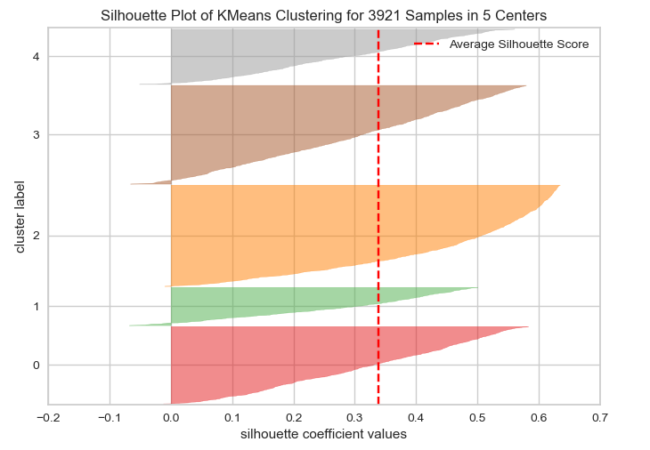
Applying K-Means Clustering

Slide 18
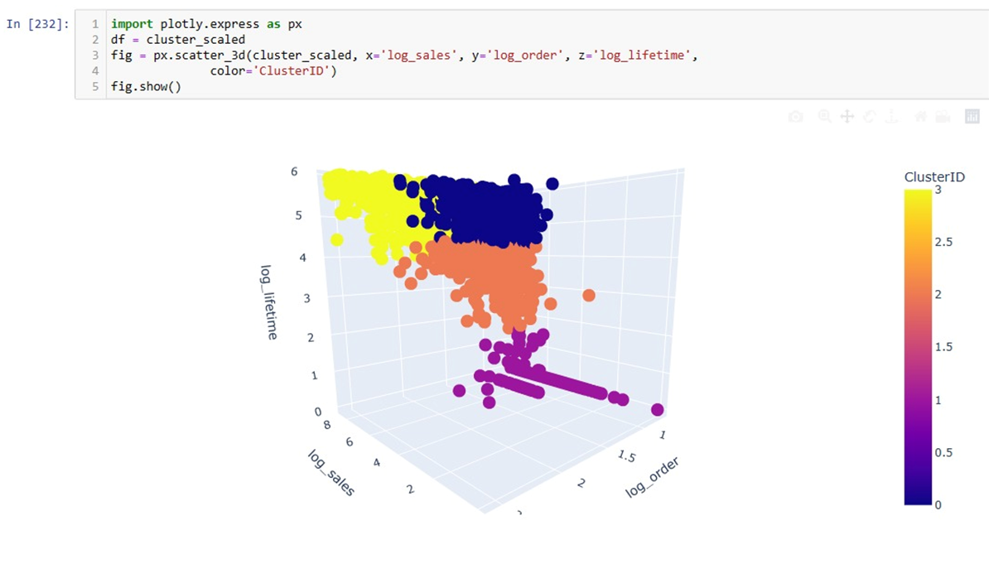
Applying K-Means Clustering

Slide 19
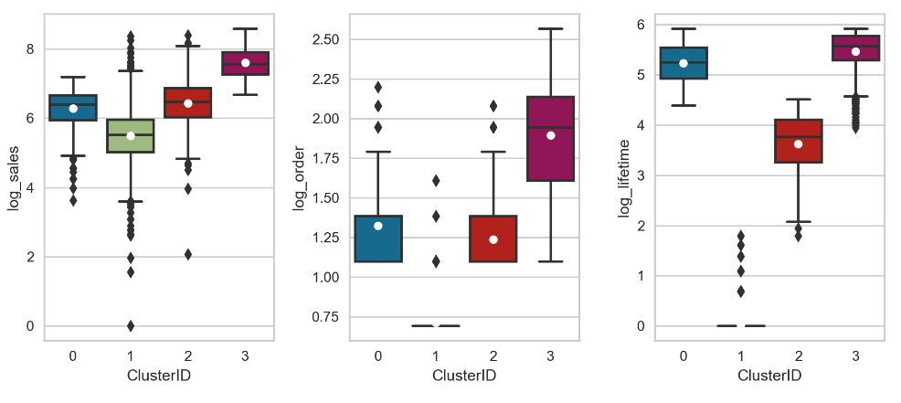
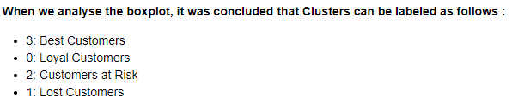
Applying K-Means Clustering

Slide 20
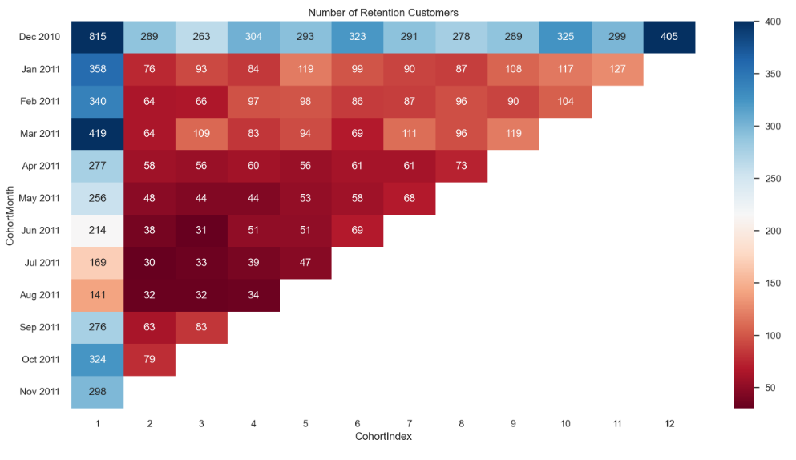
Cohort 1 - Retention

Slide 21
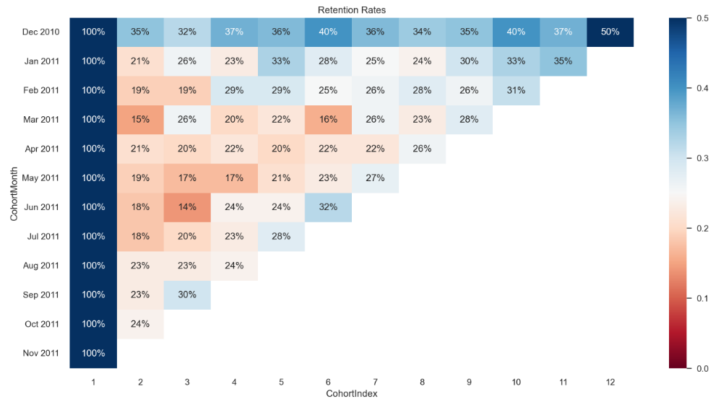
Cohort 1 - Retention

Slide 22
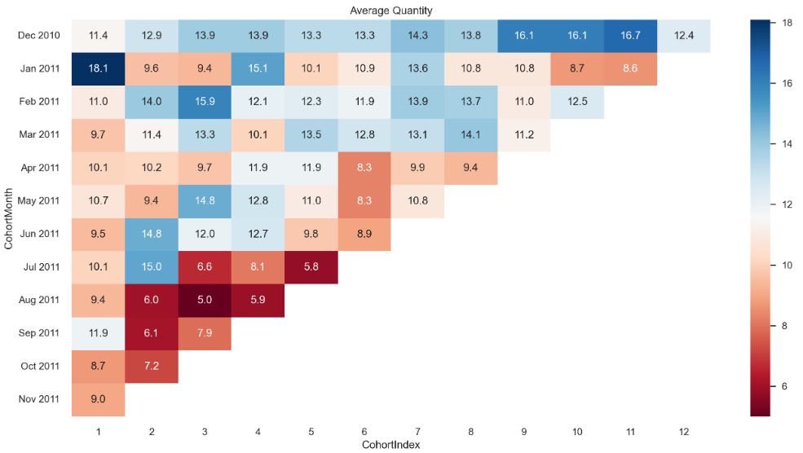
Cohort 2 - Average Quantity

Slide 23
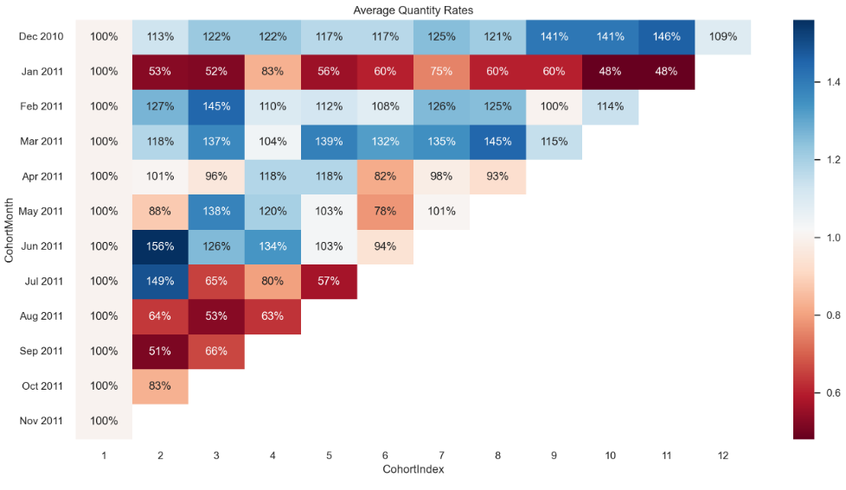
Cohort 2 - Average Quantity

Slide 24
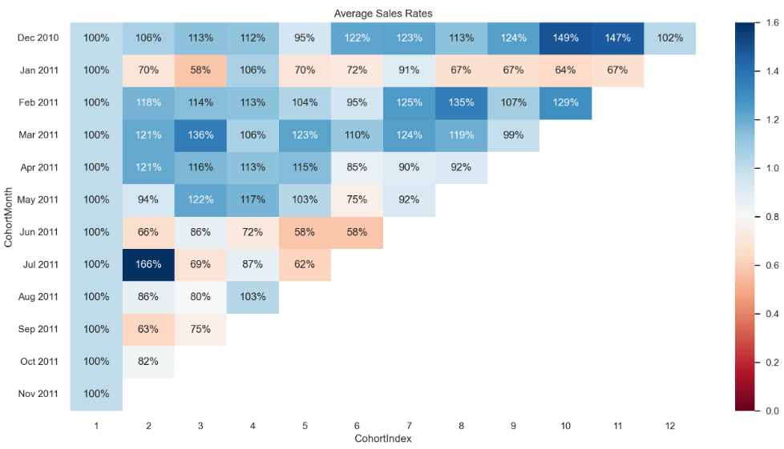
Cohort 3 - Average Sales

Slide 25
THANKS!

